Slide 1
Module 2 – Sustainable Development
Training Modules for Applying the Mitigation Hierarchy:
Planning Policy and Projects for No Net Loss or a Net Gain of Biodiversity
Module 2
Sustainable Development:
How to reconcile environment and development objectives,
set goals and prepare baselines.

Slide 2
Sustainable Development Module – Abstract
This module on ‘Sustainable Development and Conservation Targets’ explains a major challenge that governments, companies and civil society face: every country has ambitious development plans which it must reconcile with the need to conserve biodiversity.
The international context for these efforts are the Sustainable Development Goals, and also conservation targets set at the international level under the Convention on Biological Diversity and through national policy.
The module introduces the mitigation hierarchy as a key approach for reconciling environment and development goals.

Slide 3
Sustainable Development Module - Contents
Contents | Slides
Individual countries have significant development plans | 4
International Sustainable Development Goals | 5-6
Biodiversity conservation targets: The CBD, Aichi targets, and national policy | 7-9
Reconciling targets with national development | 10-13
Take home messages | 14

Slide 4
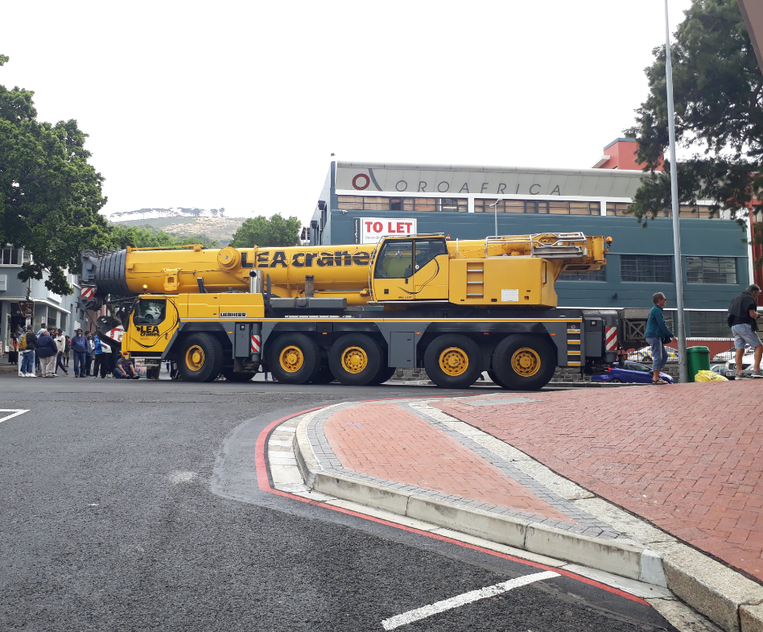
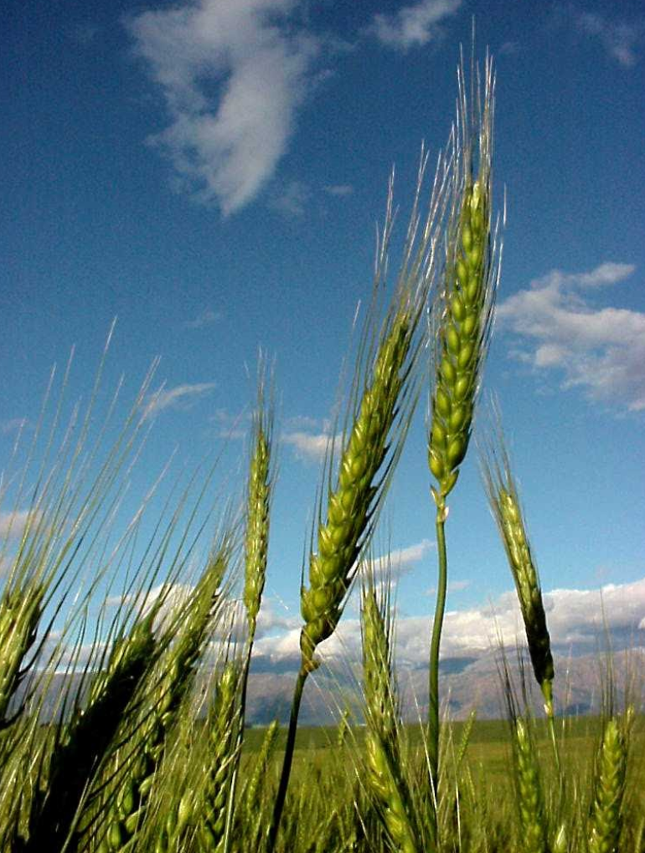
Every country has significant development plans
Between 2015 and 2030, $90 trillion need to be spent on new infrastructure assets for transportation, energy, utilities and other essential systems to match projected demand.
2/3 of this is needed in developing countries.
A 35% increase in food production by is also needed between 2012 and 2030 to feed 9 billion people.
Notes:
Actual worldwide investment in infrastructure is expected to be $79 trillion by 2040, according to WEF, but . However, the actual global investment need is closer to $97 trillion.Almost three quarters of this global infrastructure investment gap is attributable to the road and electricity sectors, with the remainder in telecommunications, rail, water, airports and ports. (Drzik, 2019)
See:
Bennett, G., Gallant, M., and ten Kate, K. 2017. State of Biodiversity Mitigation 2017: Markets and Compensation for Global Infrastructure Development. Ecosystem Marketplace, Forest Trends, Washington DC.
Mercer and IDB, 2017. Mercer and Inter-American Development Bank. 2017. Crossing the Bridge to Sustainable Infrastructure Investing: Exploring Ways to Make It Across. IDB. 10 August 2017. http://dx.doi.org/10.18235/0000675 .
FAO, 2011. FAO, 2011. State of the World's Land and Water Resources for Food and Agriculture.
Drzik, John P. 2019. Infrastructure around the world is failing. Here’s how to make it more resilient. https://www.weforum.org/agenda/2019/01/infrastructure-around-the-world-failing-heres-how-to-make-it-more-resilient/

Slide 5
Sustainable Development Goals
The 2030 Agenda for Sustainable Development, adopted by all United Nations Member States in 2015, provides a shared blueprint for peace and prosperity for people and the planet, now and into the future.
At its heart are the 17 Sustainable Development Goals (SDGs):
All the SDGs are relevant to the conservation of biodiversity and ecosystem services, but especially Goals 14 and 15.

Slide 6
Sustainable Development Goals 14 & 15
Notes:
Sources:
https://sustainabledevelopment.un.org/sdg14
https://sustainabledevelopment.un.org/sdg15

Slide 7
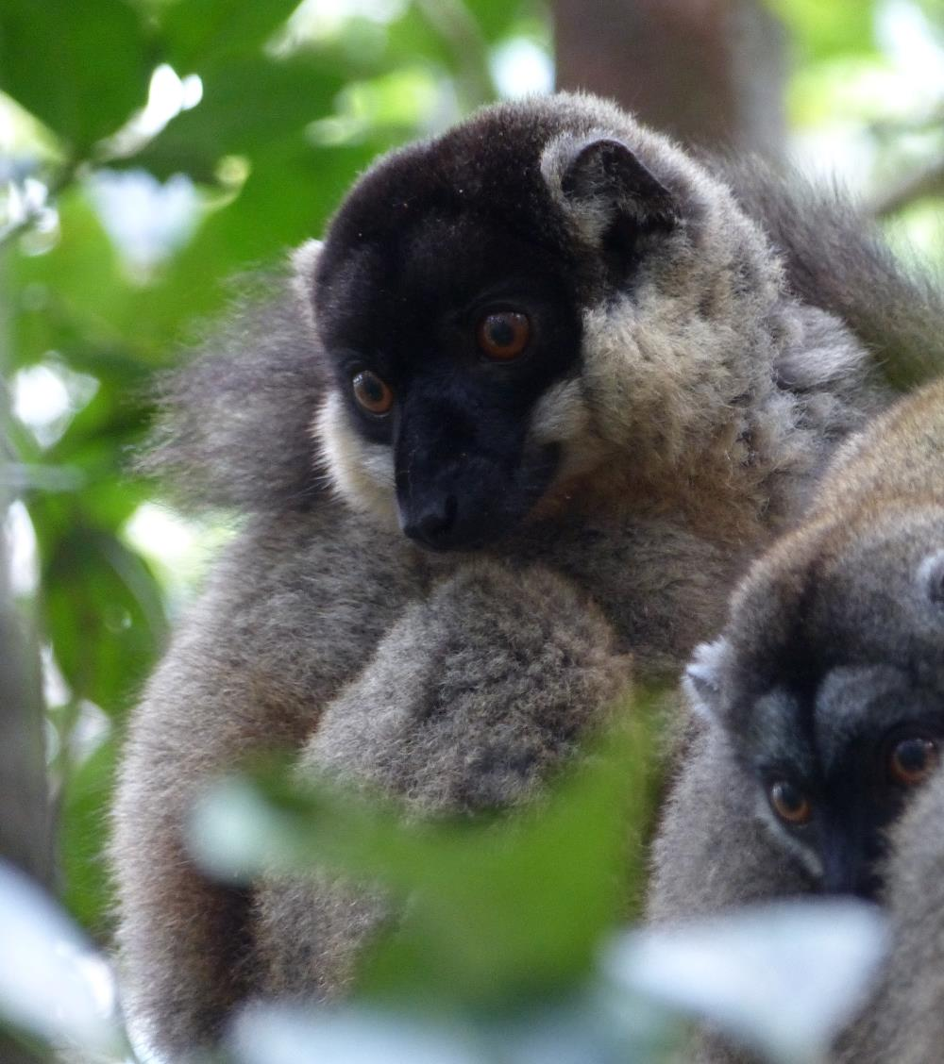
Biodiversity conservation targets
Goals and targets for the conservation of biodiversity are set:
Internationally, through treaties and agreements (such as the Convention on Biological Diversity)
Nationally, through laws, policies and plans (such as National Biodiversity Strategies and Action Plans)
Notes:
Sources:
https://www.cbd.int/
https://www.cbd.int/nbsap/

Slide 8
The Convention on Biological Diversity
The Convention on Biological Diversity (CBD) is a treaty covering many issues related to the conservation and sustainable use of biodiversity and the fair and equitable sharing of benefits. It has been ratified by 196 governments and the European Union.
In 2010, the Parties adopted a Strategic Plan for Biodiversity, including the Aichi Biodiversity Targets, for the 2011-2020 period.
There are 20 Aichi Biodiversity Targets under 5 Strategic Goals:
A. Address the underlying causes of biodiversity loss by mainstreaming biodiversity across government and society
B. Reduce the direct pressures on biodiversity and promote sustainable use
C. To improve the status of biodiversity by safeguarding ecosystems, species and genetic diversity
D. Enhance the benefits to all from biodiversity and ecosystem services
E. Enhance implementation through participatory planning, knowledge management and capacity building
Notes:
Sources:
https://www.cbd.int/sp/
https://www.cbd.int/sp/targets/

Slide 9
Aichi Targets
CBD Aichi targets. By 2020:
At least halve and, where feasible, bring close to zero the rate of loss of natural habitats, including forests
17% of terrestrial and inland water areas and 10% of marine and coastal areas protected
At least 15% of degraded ecosystems restored through conservation and restoration
The CBD will adopt a post-2020 global biodiversity framework with new targets as a stepping stone towards the 2050 Vision of "Living in harmony with nature".
A working group is negotiating development of post-2020 global biodiversity framework to be agreed at the fifteenth meeting of the CBD Conference of the Parties in Beijing, China, in October 2020.
Notes:
Sources:
http://un2020.org/timeline/timeline-cbd/

Slide 10
National policy that sets conservation goals
Countries generally have a variety of laws and policies relevant to biodiversity. These include: EIA, conservation law including protected area legislation, planning regulations, sectoral policies (eg mining, oil and gas, forestry, fisheries), fiscal policies, liability regimes, land tenure, indigenous peoples’ rights, SEA, land-use plans, and economic incentives.
Some set objectives and targets for biodiversity conservation. NBSAPs often pull these together:
National Biodiversity Strategies and Action Plans (NBSAPs)
The CBD requires parties to develop national strategies, plans or programmes for the implementation of the Convention at the national level.
NBSAPs are integrated, multisectoral, participatory instruments for national biodiversity planning and conservation.
They are intended to identify and prioritize national targets in line with the Aichi Biodiversity Targets and the actions required to meet those targets.
To date, 190 of 196 (97%) Parties have developed at least one NBSAP.
Notes:
Sources:
https://www.cbd.int/nbsap/

Slide 11
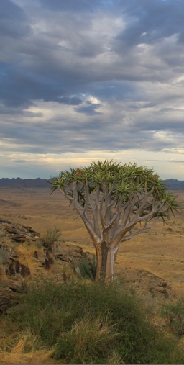
Biodiversity targets
It’s important to set outcomes-based targets for biodiversity to underpin broader sustainable development goals and commitments
Targets should:
Define the desired state of biodiversity across a country or jurisdiction
Be science-based
Be measurable
Such targets already exist in many instances (e.g. for species or ecosystems)
Mitigation policy should align with such biodiversity targets.

Slide 12
How to reconcile development goals with biodiversity conservation targets?
Biodiversity: CBD Aichi targets – by 2020:
“At least halve and, where feasible, bring close to zero the rate of loss of natural habitats, including forests”
17% of terrestrial and inland water areas and 10% of marine and coastal areas protected
At least 15% of degraded ecosystems restored through conservation and restoration
Development - by 2050:
Population 33%
Food demand 100%
Mining 60%
Energy 80%
Carbon emissions ?? 50% ??
….all bringing impacts on biodiversity
How to reconcile these?

Slide 13
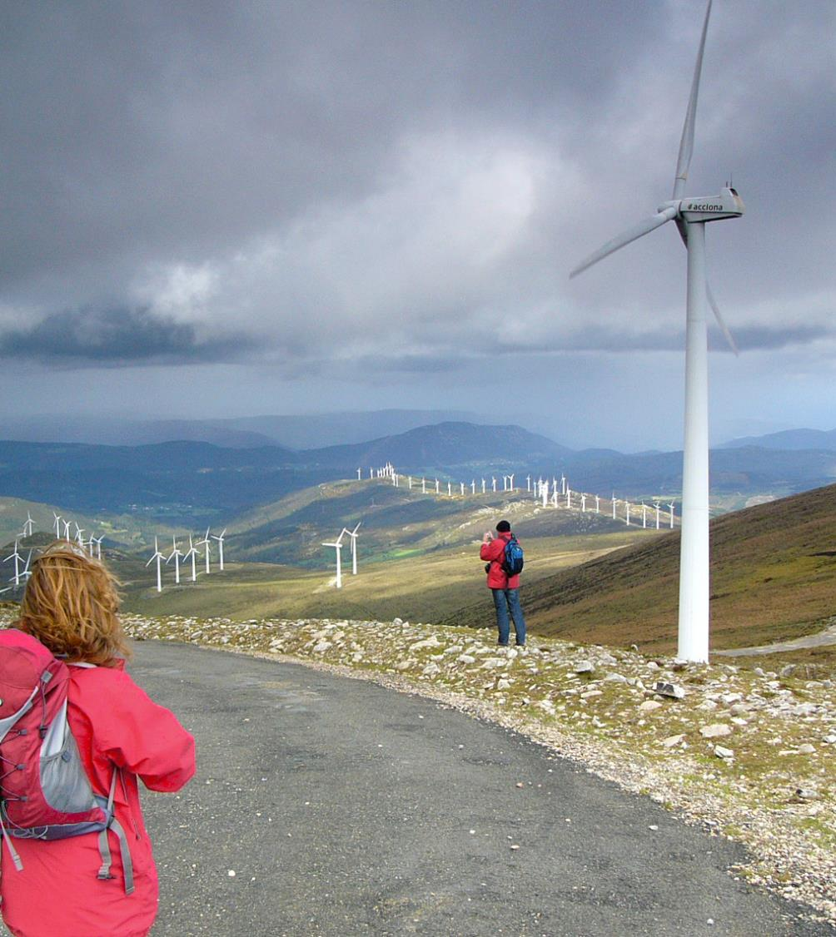
How to reconcile development with
biodiversity conservation?
Follow the ‘Mitigation hierarchy’
. . . And . . .
Plan land-use (and marine use) to achieve ‘Net Gain’ or ‘No Net Loss’ preferably - or another specific goal for biodiversity, based on overarching biodiversity targets.
Notes:
Follow the mitigation hierarchy
Avoid, to the extent possible, impacts on biodiversity
Minimise the impacts you can’t avoid
Restore after unavoidable impacts have taken place
Offset any remaining residual impacts
Define biodiversity targets (i.e. a desired outcome for biodiversity) and undertake landscape-level and seascape-level planning
Establish desired outcomes / targets for biodiversity
Review economic development anticipated over next 20 years. Review conservation values and potential outcomes at the national and regional/landscape/seascape levels.
Establish high conservation value areas where impacts on biodiversity should be avoided.
Establish priority areas as receiving areas for biodiversity offsets.
Plan location of development and conservation to achieve No Net Loss, Biodiversity Net Gain or another specific outcome for biodiversity.

Slide 14
Sustainable Development Module – Take home messages
Countries have ambitious development plans. For instance, reports suggest that between 2015 and 2030, US$90 trillion of investment is needed on new infrastructure for transportation, energy, utilities and other essential systems.
Countries have adopted the Sustainable Development Goals to endeavour to ensure social, environmental and economic development are balanced. These international goals include conserving and using marine ecosystems and resources sustainably, and protecting, restoring and promoting sustainable use of terrestrial ecosystems, including halting biodiversity loss.
The Convention on Biological Diversity also sets ambitious targets for the conservation and sustainable use of biodiversity and equitable benefit-sharing, and uses National Biodiversity Strategies and Action Plans as a tool for establishing and achieving domestic conservation targets.
Reconciling these development and conservation goals is a profound challenge. This training course proposes following the mitigation hierarchy and establishing strategies for Biodiversity Net Gain as a way to do so.

